Slide 1
FISPACT-II
Gamma Spectra resolution
FISPACT-II workshop

Slide 2
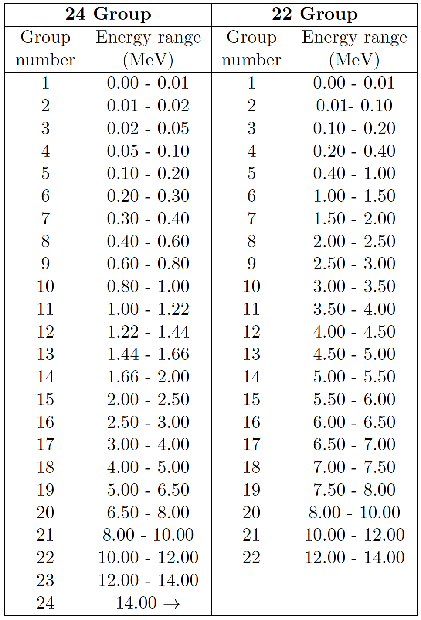
Gamma Spectra and FISPACT-II
FISPACT-II by default outputs gamma spectra for a given inventory.
This is constructed from the gamma and xray lines found in the decay data.
Xray lines can be discounted by use of the NOXRAY keyword (new for v5)
For the API setexcludexrays can be set as part of the InputData.
By default this is binned in a 24-group structure, this can be change to a 22-group structure using the GROUP keyword (GROUP 1)

Slide 3
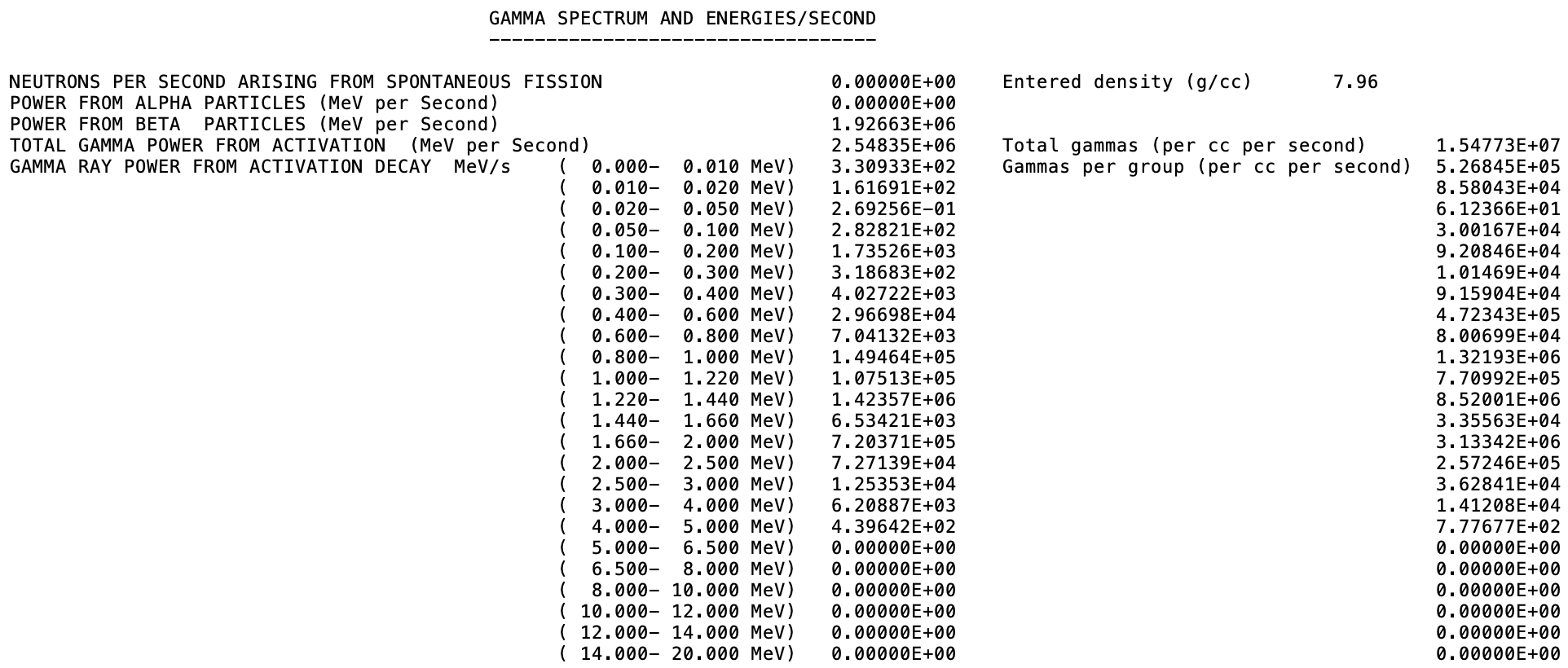
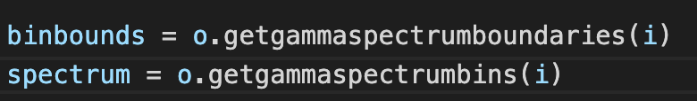
Gamma Spectra and FISPACT-II(2)
Gamma Spectra are found in the output file (.out) after the inventory.
Also included in the TAB4 and JSON outputs
Extracted from an API OutputData by the getgammaspectrumboundries (bin bounds) and getgammaspectrumbins (spectrum values) methods.
These methods take the inventory index (time step) as an argument

Slide 4
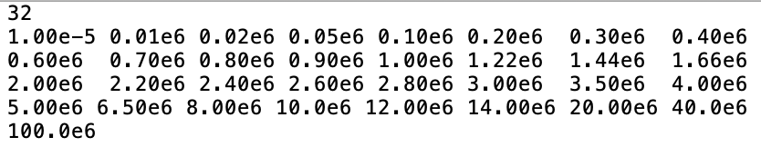
Higher resolution gamma spectra from FISPACT-II
The user can specify the gamma bin structure to be output by FISPACT-II.
This is achieved by the READGG keyword and the ggbins file stream in the files file.
ggbins points to file detailing the desired output gamma bin bounds.
The API InputData includes a setgammabounds method providing the same functionality.
This takes a list containing the boundaries as an argument
Number of bounds
Bounds are listed in eV in ascending energy order

Slide 5
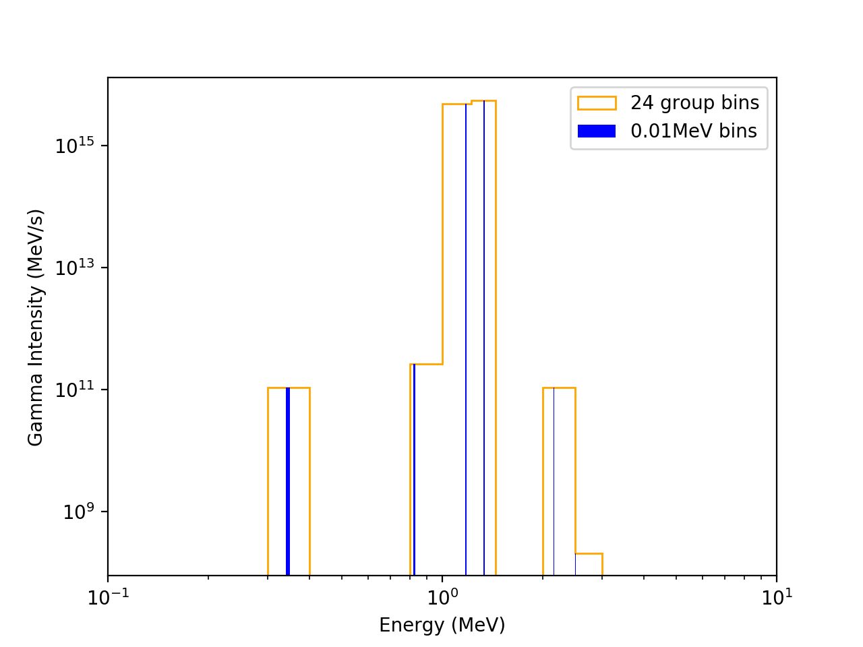
Example: ⁶⁰CO gamma spectrum
The increased energy resolution has allowed the energy separation of gamma line to be seen
The 24 groups and the 0.01MeV bin produce the same intensities
FISPACT-II decay data processing and binning routines are the same in both cases
Users can define any gamma bin structure they want.
Functionality was originally developed to allow FISPACT-II outputs to match detector resolutions

